Slide 2
The HD Field Solution
Presented by:

Slide 3
Introduction

Slide 4
Who is InEight?
InEight combines proven ability with a unified vision to help companies visualize, estimate, control and connect all aspects of their capital and maintenance projects, from the back office to the jobsite, across the project lifecycle.
Helping project-driven companies since 1989
More than 20,000 users in over 500 companies across 28 countries

Slide 5
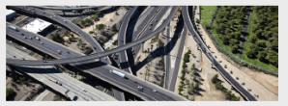
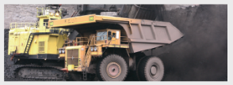
Focus on Project-Driven Industries
EC&O
Mining
Oil & Gas
Utilities
Need to standardize construction processes across the project lifecycle and consolidate crucial data to ensure all stakeholders are aligned, from back office to jobsite.
Need detailed cost estimating, performance tracking, shift reporting and feasibility data solutions that help managers reach production quickly and efficiently.
Need comprehensive, integrated solutions that provide real-time visibility to optimize operational budgets, create accurate estimates, manage costs and drive increased return on capital.
Across power generation, transmission, water, natural gas and telecommunications, these companies need solutions that provide a full spectrum of project lifecycle data to maintain compliance and increase return on capital.
Notes:
These are our four main verticals – all have project-driven companies in common.

Slide 6
Trends

Slide 7
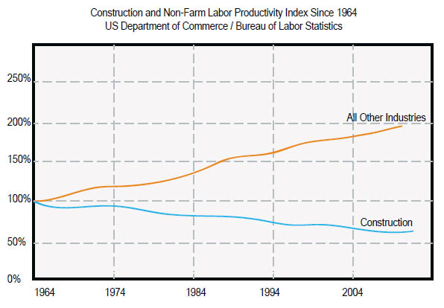
Trends in Construction
Growth U.S. construction industry will rise 9% to $612 billion this year, up from the 2014 gain of 5% to $564 billion – 2015 Dodge Construction Outlook
Productivity Construction Productivity Lags
– US Department of Commerce / BLS Collaboration Construction firms have the highest rate of work shared with outside companies, double any other industry
– Box, Inc. “The Information Economy: A Study of Five Industries”
Notes:
http://construction.com/about-us/press/construction-industry-to-see-more-balanced-growth-in-2015-according-to-DDG.asp
http://www.pewinternet.org/fact-sheets/mobile-technology-fact-sheet/

Slide 8
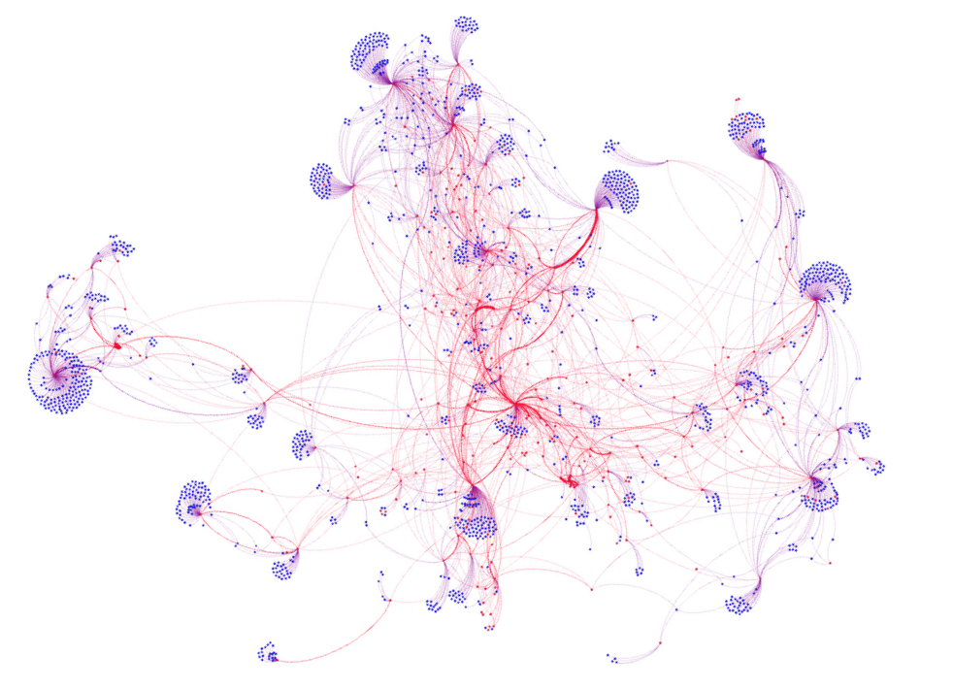
CONSTRUCTION DATA
Source: The Information Economy – A Study of Five Industries June 2014
Notes:
https://www.box.com/blog/mapping-the-information-economy-a-tale-of-five-industries/
First, let’s put it into context. In a recent study of companies in 5 different industries, one of the industries seemed to be unique: Construction. Where the other industries have lots of communication and connections between stakeholders, construction companies tend to have fewer lines of communication, given the dispersed nature of jobsites.

Slide 9
CONNECT FIELD ACTIVITY
SCATTERED FIELD DATA
DATA HARMONY

Slide 10
CONNECTED PORTFOLIO

Slide 11
InEight
Building Project Confidence

Slide 12
Mobile Trends in Construction
Is Mobile a Priority?
Mobile Device Types
Mobile Operating Systems
Mobile Functionality
Notes:
http://jbknowledge.com/wp-content/uploads/2014-JBKnowledge-Construction-Technology-Report.pdf

Slide 13
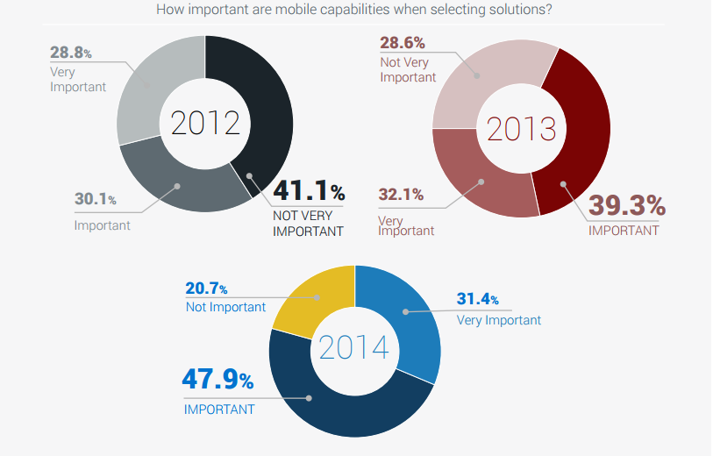
Is Mobile a Priority?
How important are mobile capabilities when selecting solutions?
Source: JBKnowledge, 2014 Construction Technology Report
Notes:
http://jbknowledge.com/wp-content/uploads/2014-JBKnowledge-Construction-Technology-Report.pdf

Slide 14
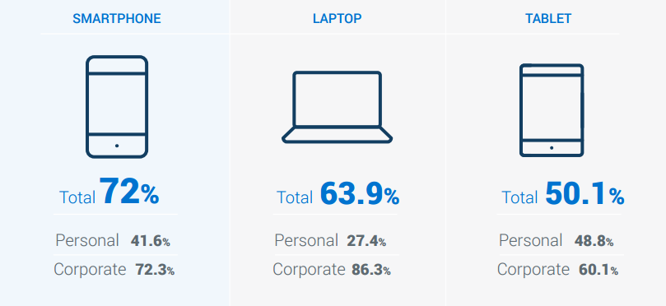
Mobile Devices
Notes:
http://jbknowledge.com/wp-content/uploads/2014-JBKnowledge-Construction-Technology-Report.pdf

Slide 15
Mobile Operating Systems
Source: JBKnowledge, 2014 Construction Technology Report
Notes:
http://jbknowledge.com/wp-content/uploads/2014-JBKnowledge-Construction-Technology-Report.pdf

Slide 16
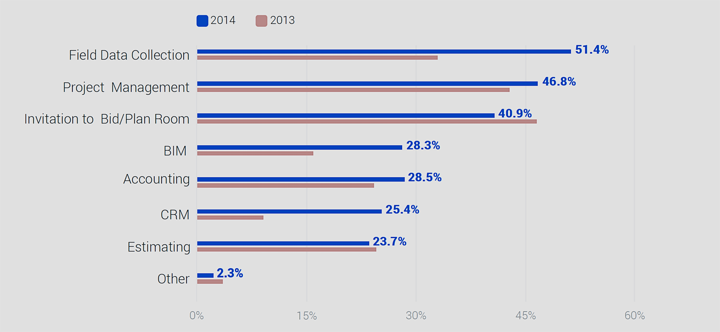
Mobile Functionality
Which of your software providers offer a mobile app?
OTHER INCLUDED • Daily Payroll & Reports • Field Service Management • Safety • Document Management
Source: JBKnowledge, 2014 Construction Technology Report
Notes:
http://jbknowledge.com/wp-content/uploads/2014-JBKnowledge-Construction-Technology-Report.pdf

Slide 17
Challenges

Slide 18
Sample Story - Superintendent
John Smith, Superintendent
Responsibility:
Manage all project activity
Problems:
Lack of visibility into jobsite activity
Misalignment between office and field
Hidden inefficiencies
Tools:
Reporting, Microsoft Excel, HD Performance
Superintendent

Slide 19
Sample Story - Foreman
Frank Williams, Foreman
Responsibility:
Assign daily tasks to crew
Problems:
Inefficient paper-based timesheets
Documenting jobsite issues
Tools:
Field book and Microsoft Excel
Foreman

Slide 20
The HD Field Solution

Slide 21
Estimating
Estimate using period resource plans; UI enhancements
Manage alternate bid item scenarios; perform Parametric estimating; visual estimating using 3D models
Performance
Rapidly update project forecasts using batch editing; UI enhancements
HD
Field Manager
Plan daily work for crews (Windows)
Field Mobile
Track field progress and timesheets (Android, Apple, Windows tablets)
Reporting
Enterprise solution including interactive dashboards and self-service reporting
ERV
Aggregate multi-discipline project models, schedule integration, visual procurement, Dimension Management and Reports using business processes
Automate visual dashboards of business data, Integration with HD, extending Connections to additional business systems
InFiniDTM
InfinyDTM
Procurement /SAP
Automate procurement processes leveraging model and SAP
Explore leveraging HANA and leveraging additional SAP system modules
ProductivyD (AWP)
Create work plans / work packages leveraging business data and 3D models
MobilyD
Perform AWP functions/inspections/ punch lists (Windows/Apple iOS)
Inspect
Perform equipment and safety inspections using checklists (Android , Apple, Windows phones)
Perform asset and work inspections /punch lists (Android or Apple iOS)
Plan
Plan and manage work orders for mechanics; Create short duration work plans / work packages (Web + Android, Apple, Windows tablets)
[Interstellar]
Progress
Track work orders and goods received (Android, Apple, Windows tablets)
Control
Manage project budgets, forecasts, progress, and changes (Cloud)
Notes:
Formatted for widescreen

Slide 22
Estimating
Estimate using period resource plans; UI enhancements
Manage alternate bid item scenarios; perform Parametric estimating; visual estimating using 3D models
Performance
Rapidly update project forecasts using batch editing; UI enhancements
HD
Field Manager
Plan daily work for crews (Windows)
Field Mobile
Track field progress and timesheets (Android, Apple, Windows tablets)
Reporting
Enterprise solution including interactive dashboards and self-service reporting
ERV
Aggregate multi-discipline project models, schedule integration, visual procurement, Dimension Management and Reports using business processes
Automate visual dashboards of business data, Integration with HD, extending Connections to additional business systems
InFiniDTM
InfinyDTM
Procurement /SAP
Automate procurement processes leveraging model and SAP
Explore leveraging HANA and leveraging additional SAP system modules
ProductivyD (AWP)
Create work plans / work packages leveraging business data and 3D models
MobilyD
Perform AWP functions/inspections/ punch lists (Windows/Apple iOS)
Inspect
Perform equipment and safety inspections using checklists (Android , Apple, Windows phones)
Perform asset and work inspections /punch lists (Android or Apple iOS)
Plan
Plan and manage work orders for mechanics; Create short duration work plans / work packages (Web + Android, Apple, Windows tablets)
[Interstellar]
Progress
Track work orders and goods received (Android, Apple, Windows tablets)
Control
Manage project budgets, forecasts, progress, and changes (Cloud)
Notes:
Formatted for widescreen

Slide 23
Data Flow
❶
Estimators and project planners create the WBS structure and budget for the project.
❻
Results are imported into the ERP system to drive payroll, and project managers can update their projects with the latest as-built hours and quantities to get updated earned values.
❷
Project engineers create crew plans by assigning foremen, employees, and equipment to tasks, validating expected results against the budget.
❺
Project engineers and company managers review and approve the executed crew plans submitted from the field.
❸
❹
Foremen receive their daily crew plans and make adjustments if necessary based on jobsite conditions and resource availability.
At the end of the shift (or throughout the day), foremen record quantities completed, hours worked, and notes, then submit for approval.

Slide 24
Benefits
Improve Visibility Connect jobsite and field office for better visibility and decisions
Save Time Speeds the entire timesheet process
Single System An integrated extension of the HD platform with single source for support
Drive Payroll Quantities flow into payroll via HD platform integration with accounting and payroll systems
Compatibility Support for full range of modern tablets – Apple, Android, and Windows

Slide 25
Demonstration

Slide 27
The HD Field Solution
❶
Estimators and project planners create the WBS structure and budget for the project.
❻
Results are imported into the ERP system to drive payroll, and project managers can update their projects with the latest as-built hours and quantities to get updated earned values.
❷
Project engineers create crew plans by assigning foremen, employees, and equipment to tasks, validating expected results against the budget.
❺
Project engineers and company managers review and approve the executed crew plans submitted from the field.
❸
❹
Foremen receive their daily crew plans and make adjustments if necessary based on jobsite conditions and resource availability.
At the end of the shift (or throughout the day), foremen record quantities completed, hours worked, and notes, then submit for approval.

Slide 30
The HD Field Solution
❶
Estimators and project planners create the WBS structure and budget for the project.
❻
Results are imported into the ERP system to drive payroll, and project managers can update their projects with the latest as-built hours and quantities to get updated earned values.
❷
Project engineers create crew plans by assigning foremen, employees, and equipment to tasks, validating expected results against the budget.
❺
Project engineers and company managers review and approve the executed crew plans submitted from the field.
❸
❹
Foremen receive their daily crew plans and make adjustments if necessary based on jobsite conditions and resource availability.
At the end of the shift (or throughout the day), foremen record quantities completed, hours worked, and notes, then submit for approval.

Slide 31
Features
Built for Everyone
Log into your app via your favorite iOS, Android or Windows tablet
To use your existing Microsoft Windows login credentials
Control user access from one central server, located at your home office
Localized - English, French Canadian and Spanish
Sync Anywhere
Set synchronization filters from your central server
Send project specific resources direct from HD to the HD Field solution
Cache project data for disconnected or offline operation
Know exactly what each foreman and/or crew should be working on, each day
Automatic integration for review, approval, rejection or modification of all times sheets
Disconnected mode - Sync when connectivity is available
Crew Planning
Superintendents can create crew plans prior to synchronization
Project managers and engineers can review and schedule crews, equipment and resources, across all projects from one single location
Project Engineers have the ability to review and approve work, marking items as either approved or modified
Superintendents can make continuous adjustments collaborating between the front office, field office and job site

Slide 32
Integration
Payroll
American Contractor, CGC, Computer Ease, Construction Partner, ContrAcct, Deltek, Dexter Chaney, Explorer, GEAC Pro-Mation, StreetSmarts, Timberline, Viewpoint, ADP
Single Sign On
Microsoft Active Directory
ERP
Automate input of specific resources
Scheduling
Microsoft Project
Primavera
Generic
XML
Excel
CSV

Slide 33
Requirements
HD Field Manager
Windows
Servers: SAP Mobile Platform (SMP), Internet Information Server (IIS)
Requires the HD Timesheet Warehouse
HD Field Mobile
Android, Apple iOS, and Windows tablets
Requires HD Field Manager

Slide 34
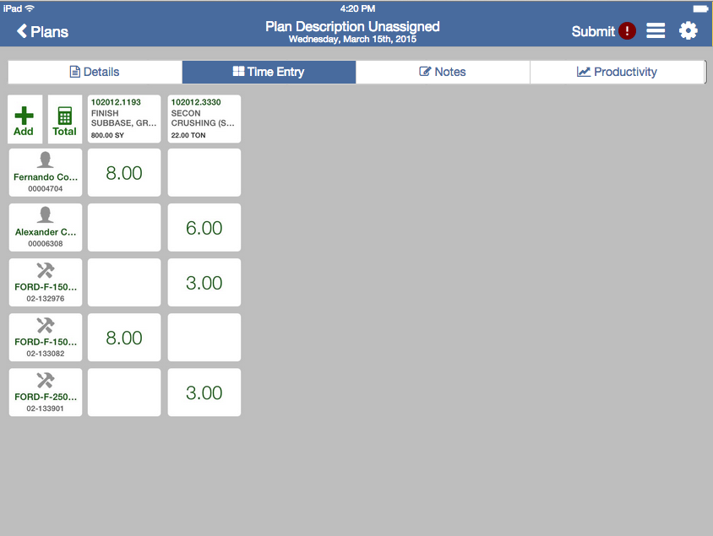
Summary
Gain real-time visibility into jobsite activity to quickly identify and address any issues.
HD Field Manager Assign crews and equipment to specific foremen for execution. Once the work is complete, any new tasks can be mapped back into the system.
HD Field Mobile Track progress and timesheets on Android, Apple iOS, and Windows tablets

Slide 35
Availability and Pricing

Slide 36
Questions?

Slide 37
marketing@ineight.com

